Slide 1
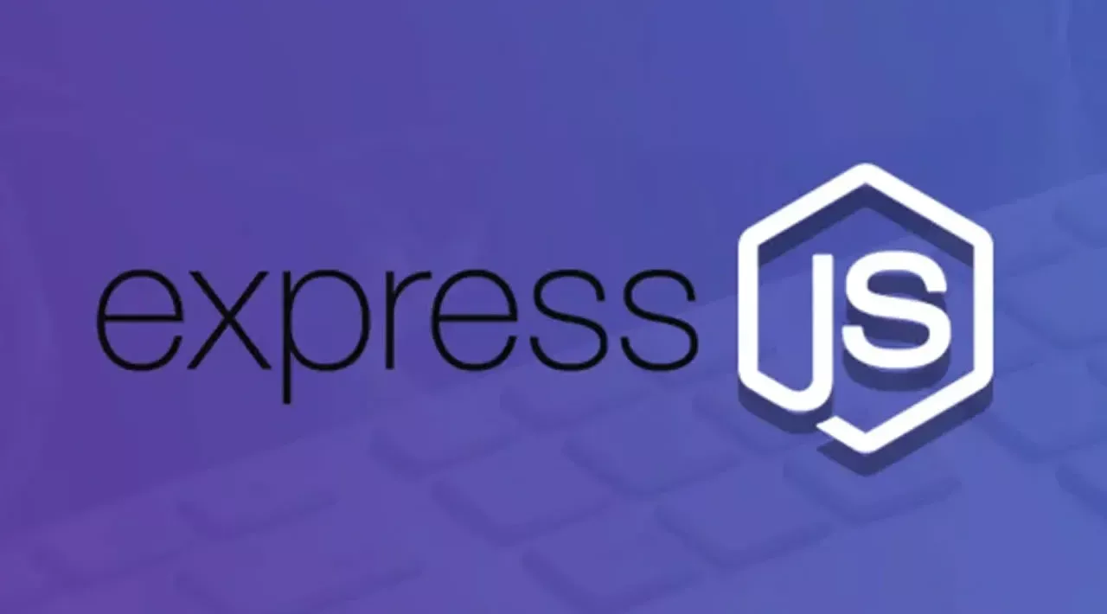

Slide 2
What is Express.js?
Express.js is a lightweight Node.js framework used to build:
Web servers
REST APIs
Backend applications
It helps developers:
Write less code
Create APIs easily
Handle routes efficiently

Slide 3
Why Use Express?
✅ Fast Development ✅ Easy Routing ✅ Middleware Support ✅ API Creation ✅ Works with MongoDB ✅ Used in MERN Stack

Slide 4

CREATE YOUR FIRST SERVER
Step 1: Create Project
Step 2: Initialize npm
Step 3: Install Express
mkdir express-app cd express-app
npm init -y
npm install express
Official website: https://expressjs.com/

Slide 5
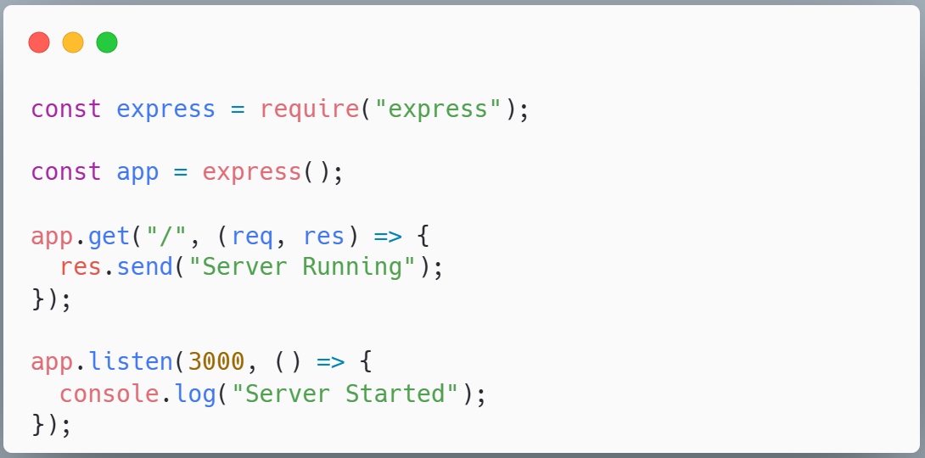
Create First Server
Server.js
Official website: https://expressjs.com/

Slide 6
Run the Server
Run Command in terminal: node server.js
Output
Server Started
Browser
http://localhost:3000

Slide 7
Understanding app.get()
app.get("/", (req, res) => { res.send("Hello");});
Explanation
app.get() → Handles GET request
/ → Route path
req → Request from client
res → Response to client
res.send() → Sends response

Slide 8
Create Multiple Routes
app.get("/", (req, res) => {
res.send(“Welcome to Home Page");
});
app.get("/about", (req, res) => {
res.send(“Welcome to About Page");
});
Return JSON Response
app.get("/api", (req, res) => {
res.json({ name: “smith", course: "MERN" });
});

Slide 9
Different HTTP Method Routes
HTTP Methods in Express.js
HTTP Methods are used to perform different operations in APIs.
1. GET Method
Used to fetch data from server.
app.get("/users", (req, res) => { res.send("Fetching Users"); });
2. POST Method
Used to send/create data.
app.post("/users", (req, res) => { res.send("User Created"); });

Slide 10
Different HTTP Method Routes
3. PUT Method
Used to update complete data.
app.put("/users", (req, res) => { res.send("User Updated"); });
4. DELETE Method
Used to delete data.
app.delete("/users", (req, res) => { res.send("User Deleted"); });

Slide 11
Query Parameters in Express.js
Query Parameters are used to send small data through the URL.
They appear after ? in the URL.
Example URL
http://localhost:3000/search?name=meenu
Here:
name = meenu
Access Query Parameters
app.get("/search", (req, res) => { res.send(req.query.name); });
Output
If URL is:
http://localhost:3000/search?name=meenu
Response:
meenu

Slide 12
Multiple Query Parameters
URL
http://localhost:3000/user?name=meenu&age=21
Route
app.get("/user", (req, res) => { const name = req.query.name; const age = req.query.age; res.send(name + " " + age); });

Slide 13
Why Use Query Parameters?
✅ Searching ✅ Filtering ✅ Sorting ✅ Pagination
Real Examples
/products?page=1 /users?age=21 /search?keyword=laptop

Slide 14
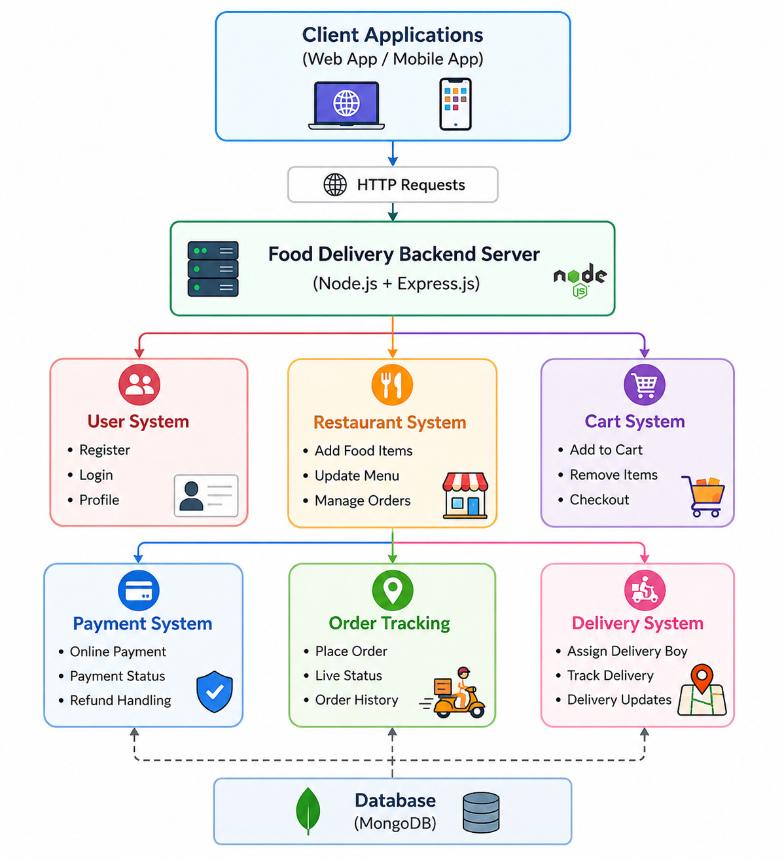
Imagine We Are Building a Food Delivery Backend Server 🍔
Apps like Zomato or Swiggy perform many backend operations simultaneously using Node.js + Express.js.

Slide 15
Real Backend APIs Examples
User APIs
POST /register POST /login GET /profile
Restaurant APIs
GET /menu POST /add-food PUT /update-food
Cart APIs
POST /add-to-cart DELETE /remove-item GET /cart
Payment APIs
POST /payment GET /payment-status

Slide 16
Complete Food Delivery APIs Example 🍔
Login User
app.post("/login", (req, res) => { const { email, password } = req.body; res.json({ message: "Login Successful", email }); });
Get Profile
app.get("/profile", (req, res) => { res.json({ id: 1, name: "Rahul", email: "rahul@gmail.com" }); });
1. User APIs
Register User
app.post("/register", (req, res) => { const user = req.body; res.json({ message: "User Registered", user }); });
Example Body
{ "name": "Rahul", "email": "rahul@gmail.com", "password": "1234" }

Slide 17
2. Restaurant APIs
Get Menu
app.get("/menu", (req, res) => { const foods = [ { id: 1, name: "Burger", price: 120 }, { id: 2, name: "Pizza", price: 250 } ]; res.json(foods); });
Add Food
app.post("/add-food", (req, res) => { const food = req.body; res.json({ message: "Food Added", food }); });
Update Food
app.put("/update-food/:id", (req, res) => { const id = req.params.id; const updatedFood = req.body; res.json({ message: "Food Updated", id, updatedFood }); });
3. Cart APIs
Add To Cart
app.post("/add-to-cart", (req, res) => { const item = req.body; res.json({ message: "Item Added To Cart", item }); });

Slide 18
Remove Item From Cart
app.delete("/remove-item/:id", (req, res) => { const id = req.params.id; res.json({ message: "Item Removed", id }); });
Get Cart
app.get("/cart", (req, res) => { const cart = [ { name: "Burger", quantity: 2 }, { name: "Pizza", quantity: 1 } ]; res.json(cart); });
4. Payment APIs
Make Payment
app.post("/payment", (req, res) => { const payment = req.body; res.json({ message: "Payment Successful", payment }); });
Payment Status
app.get("/payment-status", (req, res) => { res.json({ status: "Success", transactionId: "TXN12345" }); });

Slide 19
Final Server Setup
app.listen(3000, () => { console.log( "Food Delivery Server Running" ); });
Run the Sever

